Slide 1
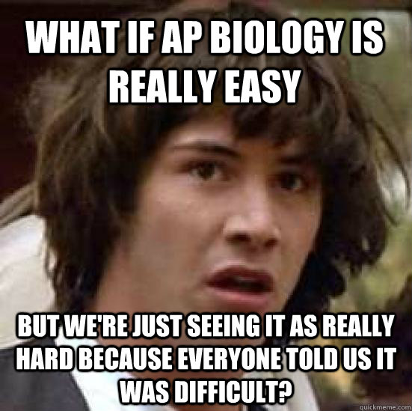
http://i.qkme.me/363u7y.jpg
TIPS FOR TAKING THE 2021 AP EXAM
By Kelly Riedell/Brookings Biology
Includes information about the AP Biology exam from the 2019 Course and Exam Description (CED)
and suggestions based on my experiences as an AP BIOLOGY teacher

Slide 2

https://www.allexamgurublog.com/2016/07/introduction-to-sociology-questions-and-answers.html
2021 AP BIO EXAM will be different this year
3 TESTING DATES
MAY 14 - In person/paper exam
May 27- On line digital exam
June 11- On line digital exam
All AP Exams, regardless of format, will be full length.
IF YOU ARE TAKING THE DIGITAL EXAM, QUESTIONS MUST BE ANSWERED IN ORDER. You will NOT be able to go back to a question.

Slide 3
https://www.allexamgurublog.com/2016/07/introduction-to-sociology-questions-and-answers.html
FROM TREVOR PACKER: 7 FAST FACTS ABOUT THE 2021 AP EXAMS
If you’re taking digital AP Exams, you must complete these three steps before exam day.
Download the exam application.
  Download the application on the device you’ll use on exam day.
  If you’re using a school-managed device, be sure to find out when the app will be installed for you.
Practice in the application.
  2 types of practice are available:
    App Demo: Quickly confirm that the application is correctly installed, that questions display appropriately, and that you can enter answers.
    Digital Practice: Fully explore the digital testing application.
  Remember to practice only when you have enough time to finish and on the device that you'll use to test. To see how long practice is for your course, visit your course’s exam page.
Complete exam setup.
  For each digital AP Exam you take, you must complete the exam setup step in the digital testing app. This step loads your exam onto the computer you’re going to test with.
  You’re required to take this step 1–3 days before each exam. If you don’t take this step for each exam, you won’t be able to test

Slide 4
https://www.allexamgurublog.com/2016/07/introduction-to-sociology-questions-and-answers.html
MULTIPLE CHOICE QUESTIONS
If you don’t understand the question, look at
the answer choices for clues for what the
question is about.
Each question counts the same. Don’t get stuck on a question. Make your best guess.
Otherwise you may run out of time and not get to answering some questions that you may know the answers to.
If you absolutely don’t have a clue, guess.
Don’t leave any blank. There’s NO penalty for guessing.

Slide 5
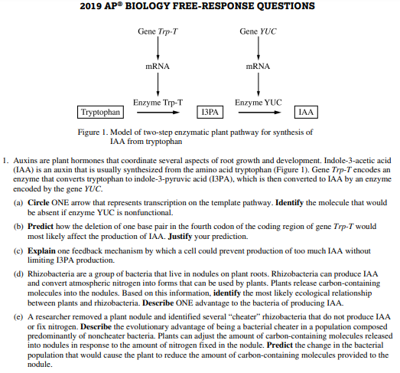
https://secure-media.collegeboard.org/apc/ap19-frq-biology.pdf
NOTE: THIS IS NOT A SECURE TEST QUESTION
It is posted on the College Board website
If you are taking the in person/paper exam.
Read through the FRQ questions 1st and circle the POWER WORDS
Each of these is a
POINT!
As you write your answers, check back to see if you are hitting these.

Slide 6
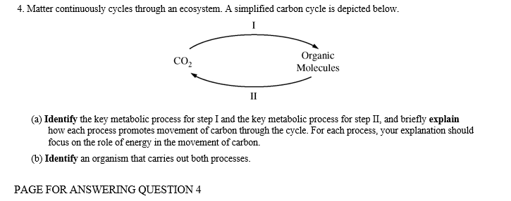
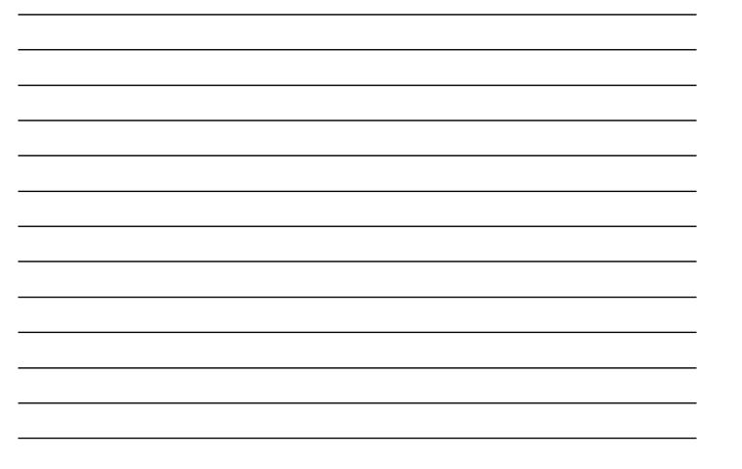
https://secure-media.collegeboard.org/digitalServices/pdf/ap/apcentral/ap13_frq_biology.pdf
If you are taking the in person/paper exam
Read through the questions again. Jot down some notes here
What do you know?
What do you want to be sure and include in your answer?
What will help you answer the ?
BUT REMEMBER Only answers written HERE can earn points!
NOTE: THIS IS NOT A SECURE TEST QUESTION
It is posted on the College Board website

Slide 7


https://media.istockphoto.com/illustrations/brain-freeze-illustration-id166010577
http://www.clipartbest.com/thinking-cartoon-gif
FRQ’s
On a big point question even if you can’t answer all the parts look to see if there are one or two parts you know something about and answer those.
Describe it, if you can’t name it.

Slide 8


WRITE
LEGIBLY
https://www.facebook.com/photo.php?fbid=10156868450043937&set=gm.2311799459086488&type=3&theater&ifg=1
https://www.facebook.com/photo.php?fbid=10216725116578015&set=gm.2308940229372411&type=3&theater&ifg=1

Slide 9
FORGET WHAT YOUR ENGLISH TEACHER TOLD YOU ABOUT WRITING ESSAYS!
GET TO THE GUTS!
NO introductory/closing paragraphs
DON’T rewrite the ? stem in your answer

Slide 10
THESE ARE ESSAY QUESTIONS!
~ USE COMPLETE SENTENCES
~ NO BULLETS*
* UNLESS THE POWER WORDS ASK YOU TO
IDENTIFY or LIST

Slide 11

MAKE IT EASY FOR THE READER TO FIND YOUR ANSWERS
https://www.facebook.com/photo.php?fbid=10215152835950449&set=gm.2311330409133393&type=3&theater&ifg=1

Slide 12
MAKE IT EASY FOR THE READER TO FIND YOUR ANSWERS
THAT SAID . . .
If you don’t label your sections OR if you write an answer to part A in with your part B answer it still counts. The reader will find it.

Slide 13
Readers will read every word you write.
If you answer correctly, then contradict your answer later you lose that earned point.
If you answer incorrectly then go on to correct your error. You get the point.

Slide 14

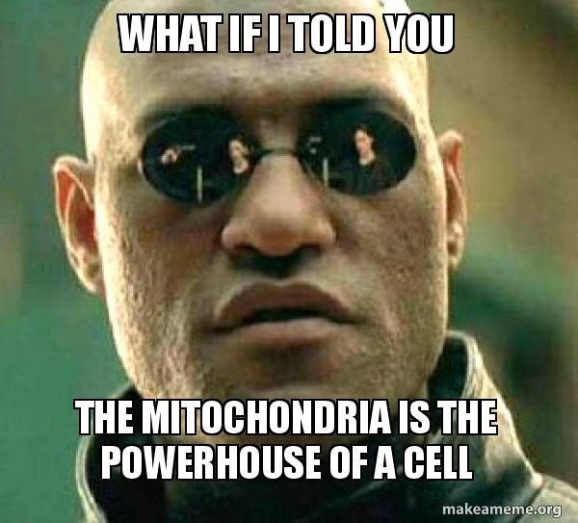
NO POINTS FOR JUST REPEATING INFO GIVEN IN THE PROMPT
USE AP LEVEL VOCAB
SHOW WHAT YOU KNOW
You are trying to show that you understand enough
to earn credit for a year of college level biology
https://media.makeameme.org/created/what-if-i-6240ud.jpg

Slide 15
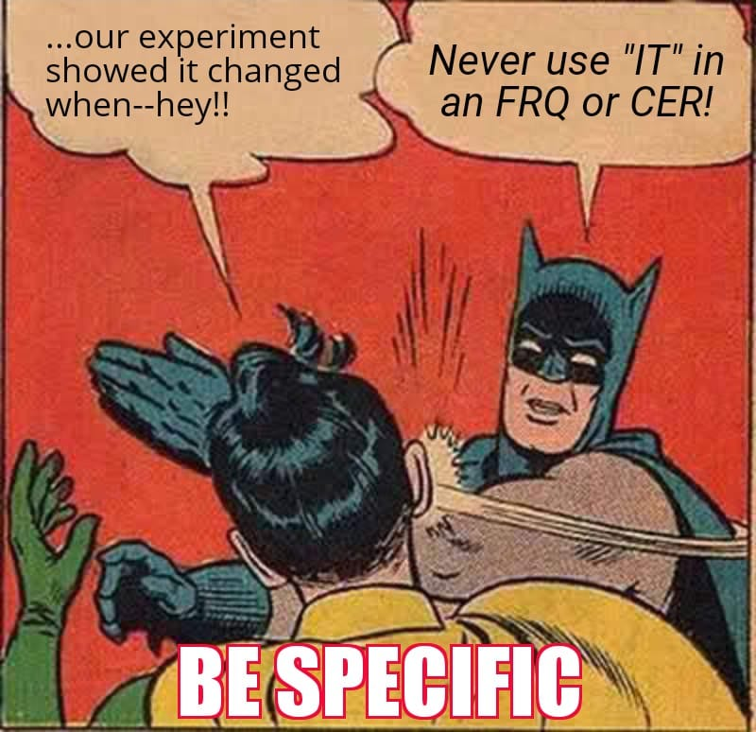
WATCH YOUR PRONOUNS
IT CHANGED.
What changed?
How did it change?
How do you know?
Don’t be vague/over dramatic
It will > > >
. . . be harmful to organism
. . . will help organism
. . . Everything will die.
https://www.facebook.com/photo.php?fbid=10213781773914903&set=p.10213781773914903&type=3&theater

Slide 16
ANSWERS SHOULD BE COMPLETE!
Units with Numbers:
When asked to discuss quantitative data, don’t forget to include units. Credit is not granted for numbers without units.
Directionality in Trends:
If asked to describe a trend, be sure to address whether the trend is increasing, decreasing or remaining constant.
Making Comparisons:
If asked to compare two groups or explain differences between them, be sure you address BOTH groups, not just one.
Slide from LEE FERGUSON

Slide 17


http://inpathybulletin.com/wp-content/uploads/2014/06/erasing-your-VP-mistakes.jpg
IF YOU MAKE A MISTAKE . . .
Simply draw a line through it.
http://quotespictures.com/wp-content/uploads/2013/07/theres-nothing-wrong-with-making-mistakes-whats-wrong-is-letting-a-mistake-stay-a-mistake-without-putting-if-effort-to-make-it-right.png

Slide 18
KNOW WHAT THEY ARE ASKING FOR
EVERY POWER WORD IS A POINT!
JUSTIFY
DISCUSS
IDENTIFY
DESCRIBE
EXPLAIN
PREDICT
PROVIDE REASONING
CALCULATE
MAKE A CLAIM
PROVIDE EVIDENCE
DRAW/CONSTRUCT
Practice the words
QUIZLET

Slide 19
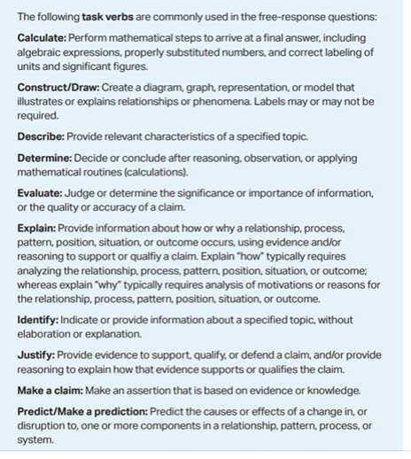
PAGE 199 in new 2019 CED

Slide 20
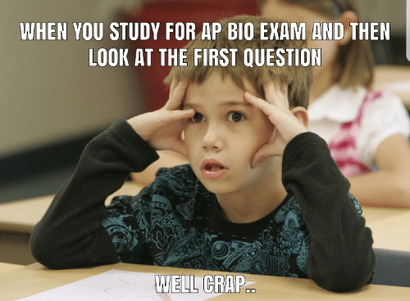
THERE WILL BE STUFF ON THE EXAM YOU DIDN’T LEARN
At first glance, the questions may
look complicated and are about things
you never learned BUT . . .
You don’t have to know how to cure
cancer or understand bee psychology.
Look closer. They ARE really asking about things you learned about like cell structure, ecosystems, hypo/hypertonic situations, gene regulation, cell signaling, transport, symbiotic relationships, genetics, evolutionary processes, homeostasis, metabolism, food chains, water potential . . .
https://me.me/i/when-you-study-for-ap-bio-exam-and-then-look-660f27aef726442fa4b99912b6d9ed8d

Slide 21


https://secure-media.collegeboard.org/ap/pdf/ap-biology-frq-2017.pdf
NOTE: THIS IS NOT A SECURE TEST QUESTION
It is posted on the College Board website
2017 EXAM
Many species of bacteria grow in the mouth of animals and can form biofilms on teeth (plaque). Within plaque, the outer layers contain high levels of oxygen and the layers closest to the tooth contain low levels of oxygen. The surface of the tooth is covered with a hard layer of enamel, which can be dissolved under acidic conditions. When the enamel breaks down the bacteria in plaque can extract nutrients from the tooth and cause cavities.
Certain types of bacteria (e.g., Streptococcus mutans) thrive in the innermost anaerobic layers of the plaque and are associated with cavities. Other types of bacteria (Streptococcus sanquinis) compete with S. mutans but are unable to thrive in acidic conditions.
IDENTIFY the biochemical pathway S. mutans uses for metabolizing sugar and DESCRIBE how the pathway contributes to the low pH in the inner layers of plaque.
(b) Normal tooth brushing effectively removes much of the plaque from the flat surfaces but cannot reach the surfaces
between teeth. Many commercial toothpastes contain alkaline components which raise the pH of the mouth. PREDICT
how the population size of S. mutans AND S. sanguinis in the bacterial community in the plaque between teeth are likely
to change when these toothpastes are used.
Biofilms???
Streptococcus mutans???
Cavities ? ? ?
REALLY ?
WE NEVER STUDIED THIS !
Images from:
https://www.pinterest.com/sum1610/emoji/
https://www.elitedaily.com/social-news/new-ios-update-sassy-emojis/1677642

Slide 22
THERE WILL BE STUFF ON THE EXAM YOU DIDN’T LEARN
LOOK CLOSER AT THE QUESTIONS.
WHAT ARE THEY ASKING ABOUT?
IDENTIFY the biochemical pathway S. mutans uses for metabolizing sugar and DESCRIBE how the pathway contributes to the low pH in the inner layers of plaque.
(b) Normal tooth brushing effectively removes much of the plaque from the flat surfaces but cannot reach the surfaces
between teeth. Many commercial toothpastes contain alkaline components which raise the pH of the mouth. PREDICT
how the population size of S. mutans AND S. sanguinis in the bacterial community in the plaque between teeth are likely to
change when these toothpastes are used.
NOTE: THIS IS NOT A SECURE TEST QUESTION
It is posted on the College Board website

Slide 23
THERE WILL BE STUFF ON THE EXAM YOU DIDN’T LEARN
LOOK CLOSER AT THE QUESTIONS.
WHAT ARE THEY ASKING ABOUT?
IDENTIFY the biochemical pathway S. mutans uses for metabolizing sugar and DESCRIBE how the pathway contributes to the low pH in the inner layers of plaque.
(b) Normal tooth brushing effectively removes much of the plaque from the flat surfaces but cannot reach the surfaces
between teeth. Many commercial toothpastes contain alkaline components which raise the pH of the mouth. PREDICT
how the population size of S. mutans AND S. sanguinis in the bacterial community in the plaque between teeth are likely to
change when these toothpastes are used.
They are asking about pathways for metabolizing sugar.
I KNOW you learned about fermentation and cellular respiration!
a) How are fermentation/cellular respiration impacted by the presence/absence of oxygen?
Where would each of these be happening?
Which of these could affect the pH and make the inner layer more acidic?
b) is asking how changing an environment might affect populations that live there. If you know
something about the characteristics of the populations, you should be able to make a prediction
about which population would respond best to the new more alkaline conditions.

Slide 24
THERE WILL BE STUFF ON THE EXAM YOU DIDN’T LEARN
Even if it seems like the question is about something you never learned, the prompt will contain information to help steer you towards what they are looking for and help you answer the question.
LOOK AT THE PROMPT.
WHAT INFORMATION ARE YOU GIVEN TO HELP YOU ANSWER THE QUESTIONS?
2017 EXAM
Many species of bacteria grow in the mouth of animals and can form biofilms on teeth (plaque). Within plaque, the outer layers contain high levels of oxygen and the layers closest to the tooth contain low levels of oxygen. The surface of the tooth is covered with a hard layer of enamel, which can be dissolved under acidic conditions. When the enamel breaks down the bacteria in plaque can extract nutrients from the tooth and cause cavities.
Certain types of bacteria (e.g., Streptococcus mutans) thrive in the innermost anaerobic layers of the plaque and are associated with cavities. Other types of bacteria (Streptococcus sanquinis) compete with S. mutans but are unable to thrive in acidic conditions.
NOTE: THIS IS NOT A SECURE TEST QUESTION
It is posted on the College Board website

Slide 25
https://secure-media.collegeboard.org/ap/pdf/ap-biology-frq-2017.pdf
NOTE: THIS IS NOT A SECURE TEST QUESTION
It is posted on the College Board website
2017 EXAM
Many species of bacteria grow in the mouth of animals and can form biofilms on teeth (plaque). Within plaque, the outer layers contain high levels of oxygen and the layers closest to the tooth contain low levels of oxygen. The surface of the tooth is covered with a hard layer of enamel, which can be dissolved under acidic conditions. When the enamel breaks down the bacteria in plaque can extract nutrients from the tooth and cause cavities.
Certain types of bacteria (e.g., Streptococcus mutans) thrive in the innermost anaerobic layers of the plaque and are associated with cavities. Other types of bacteria (Streptococcus sanquinis) compete with S. mutans but are unable to thrive in acidic conditions.
Outer layer has HIGH levels of oxygen
Inner layer has LOW levels of oxygen.
S. mutans bacteria thrive here.
S. sanquinis bacteria are unable to thrive in acidic conditions

Slide 26

https://secure-media.collegeboard.org/ap/pdf/ap-biology-frq-2017.pdf
NOTE: THIS IS NOT A SECURE TEST QUESTION
It is posted on the College Board website
2017 EXAM
Many species of bacteria grow in the mouth of animals and can form biofilms on teeth (plaque). Within plaque, the outer layers contain high levels of oxygen and the layers closest to the tooth contain low levels of oxygen. The surface of the tooth is covered with a hard layer of enamel, which can be dissolved under acidic conditions. When the enamel breaks down the bacteria in plaque can extract nutrients from the tooth and cause cavities.
Certain types of bacteria (e.g., Streptococcus mutans) thrive in the innermost anaerobic layers of the plaque and are associated with cavities. Other types of bacteria (Streptococcus sanquinis) compete with S. mutans but are unable to thrive in acidic conditions.
IDENTIFY the biochemical pathway S. mutans uses for metabolizing sugar and DESCRIBE how the pathway contributes to the low pH in the inner layers of plaque.
(b) Normal tooth brushing effectively removes much of the plaque from the flat surfaces but cannot reach the surfaces
between teeth. Many commercial toothpastes contain alkaline components which raise the pH of the mouth. PREDICT
how the population size of S. mutans AND S. sanguinis in the bacterial community in the plaque between teeth are likely to
change when these toothpastes are used.
NOW YOU CAN ANSWER THE QUESTIONS !
Check the Scoring Guidelines to see how you did
https://www.mediapost.com/publications/article/322395/emojis-score-with-mobile-users.html

Slide 27

PAY ATTENTION TO GRAPHS/PICTURES
Sometimes just looking at the
picture can give you the answer
to the question
https://i0.kym-cdn.com/photos/images/original/000/962/553/000.jpg

Slide 28
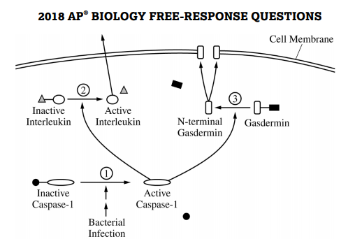
https://secure-media.collegeboard.org/ap/pdf/ap18-frq-biology.pdf
NOTE: THIS IS NOT A SECURE TEST QUESTION
It is posted on the College Board website
?
?
Check SCORING GUIDELINES to see how you did
DESCRIBE the effect of inhibiting step 3 on the formation of pores AND the release of interleukin from the cell

Slide 29
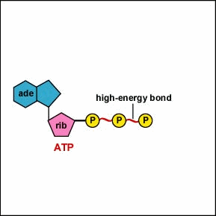
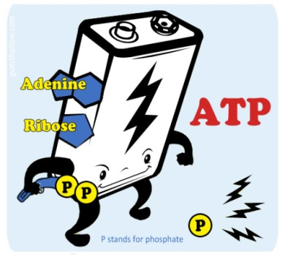
ATP
ANSWER THE PROMPT
2003 B #3
DESCRIBE how the properties of water contribute to TWO of the following.
-transpiration
- thermoregulation in endotherms
- plasma membrane structure
If it asks for TWO only the first 2 you write about count for points.
So if you write about 3 or 4 you wasted writing time and
if the 2nd one you write about is incorrect, even if your 3rd or 4th answers are correct, you won’t get any more points.
Check SCORING GUIDELINES to see how you did
NOTE: THIS IS NOT A SECURE TEST QUESTION
It is posted on the College Board website

Slide 30
ATP
NOTE: THIS IS NOT A SECURE TEST QUESTION
It is posted on the College Board website
ANSWER THE PROMPT
2001 #4
DISCUSS the following in relation to proteins.
b) The roles of DNA and RNA in protein synthesis
There is plenty you could write about DNA and RNA. . . their structure, what nucleotides they contain, how they are alike or different, role in horizontal gene transfer and viral life cycles, experiments that lead to their discovery, the steps/enzymes involved in DNA replication, DNA as the carrier of genetic code . . .
NONE OF THIS GETS YOU ANY POINTS !
NOTICE “in protein synthesis” in the prompt. Before you start writing,
MAKE SURE YOU ARE ANSWERING WHAT THE QUESTION IS ASKING FOR ! Don’t just do a “brain dump” about everything you know about DNA and RNA.
Check SCORING GUIDELINES to see how you did

Slide 31
WHAT WILL BE ON THE EXAM?
I DON’T PRETEND TO KNOW BUT . . .

Slide 32
60 Multiple choice questions (50% of Exam score)
90 minutes
~ Discrete questions
~ Question sets (4-5 ?’s)
Free Response Questions (FRQs) (50% of Exam score)
90 minutes
2 long questions (8-10 points)
~ Interpret and evaluate experimental results
~ Interpret and evaluate experimental results with graphing
4 short answer ?’s (4 points) assess students’ understanding of the following:
~ Scientific investigation
~ Conceptual analysis
~ Analysis of a model or visual representation
~ Data analysis
*Grid in questions have been removed but mathematical calculations will still be assessed in MC and FRQ sections
FROM 2019 CED

Slide 33
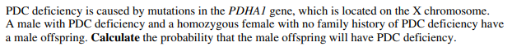
NOTE: THESE are NOT SECURE TEST QUESTIONS
NO BUBBLE-IN MATH QUESTIONS THIS YEAR BUT THEYR’E
NOT GONE. . . WILL BE IN FRQ’s or MC SECTIONS
TYPES OF MATH CALCULATION QUESTIONS
2019 Exam
In a certain group of African people, 4 percent are born with sickle cell anemia. What percentage of the group has the selective advantage of being more resistant to malaria than those individuals who are homozygous for normal hemoglobin or for sickle cell anemia?
(A) 2%
(B) 4%
(C) 8%
(D) 16%
(E) 32%
1986 Exam

Slide 34

In the past the AP Biology content was immense and covered a vast number of topics. Not a lot of guidance was provided about the specifics of what would be on the exam.
However, the new 2019 Course and Exam Description (CED) has narrowed the scope of the exam by eliminating some topics like plants and human anatomy/body systems.
In addition, the new CED has made it easy to know how exactly the 2020 and future tests will be laid out and what the questions will be about.
NOTE:
*These can still be used as examples but are no longer covered in depth.

Slide 35
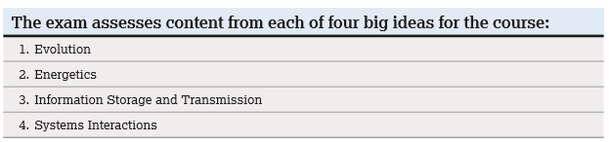
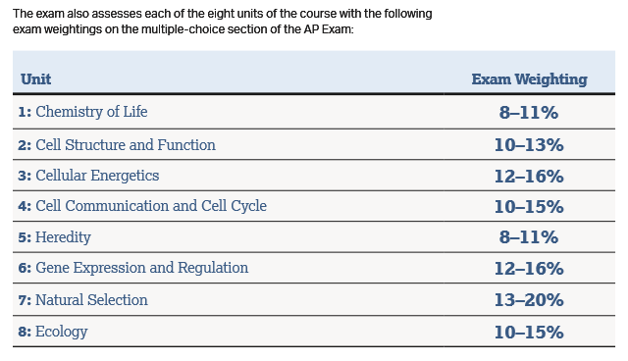
HOW WILL THE TOPICS BE TESTED?
FROM 2019 CED

Slide 36
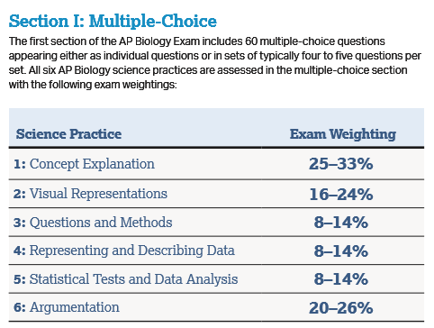
FROM 2019 CED
HOW WILL THE TOPICS BE TESTED?

Slide 37
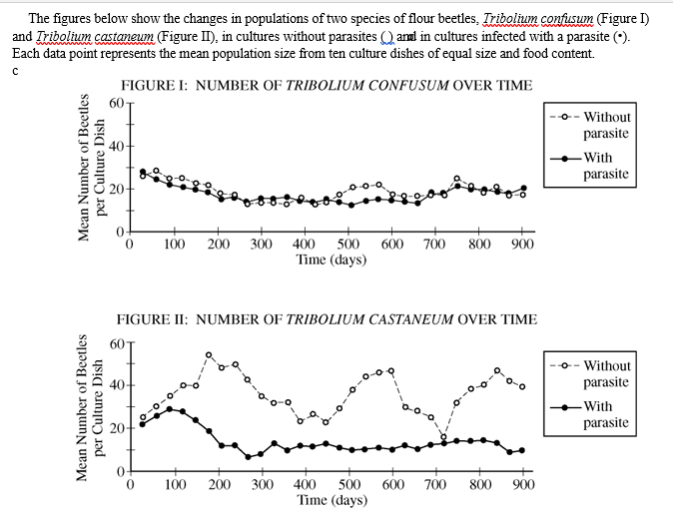
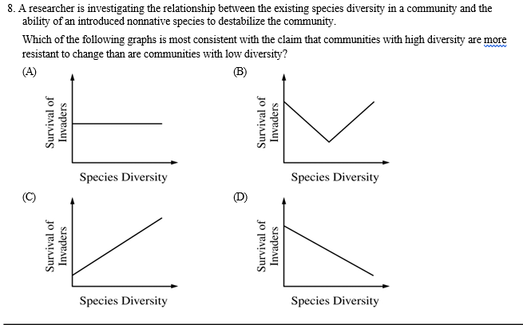
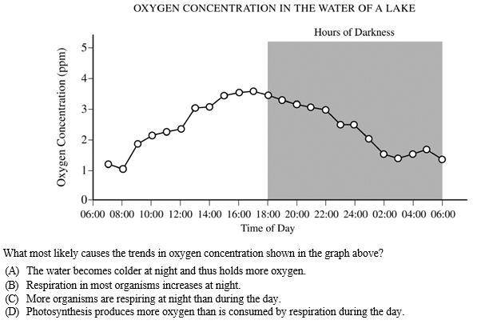
WHAT COULD BE ON THE EXAM????
EXPECT to see/interpret graphs in
MC questions on the
AP Biology Exam
EXAMPLES OF TYPES OF QUESTIONS FROM PAST MC EXAMS:
Interpret data from graphs provided
Predict what a graph might look like
Provide explanations for biological phenomena shown in a graph
Graphs are from 2013 AP BIO released exam
NOTE: THESE are NOT SECURE TEST QUESTIONS

Slide 38
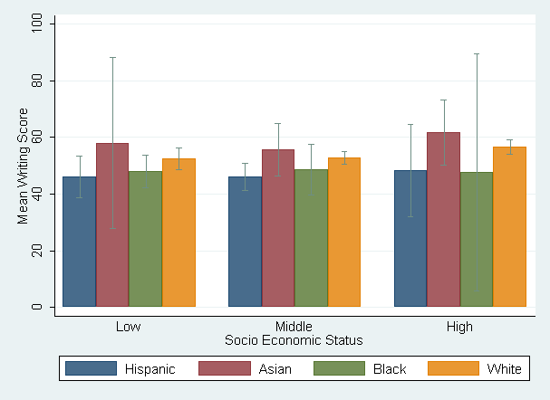
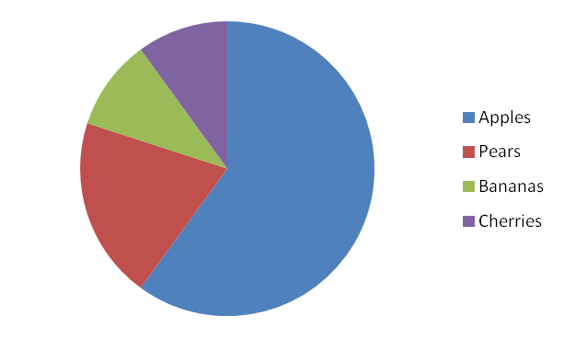
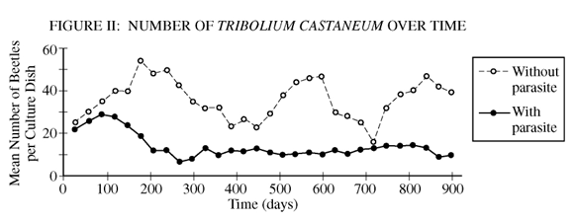
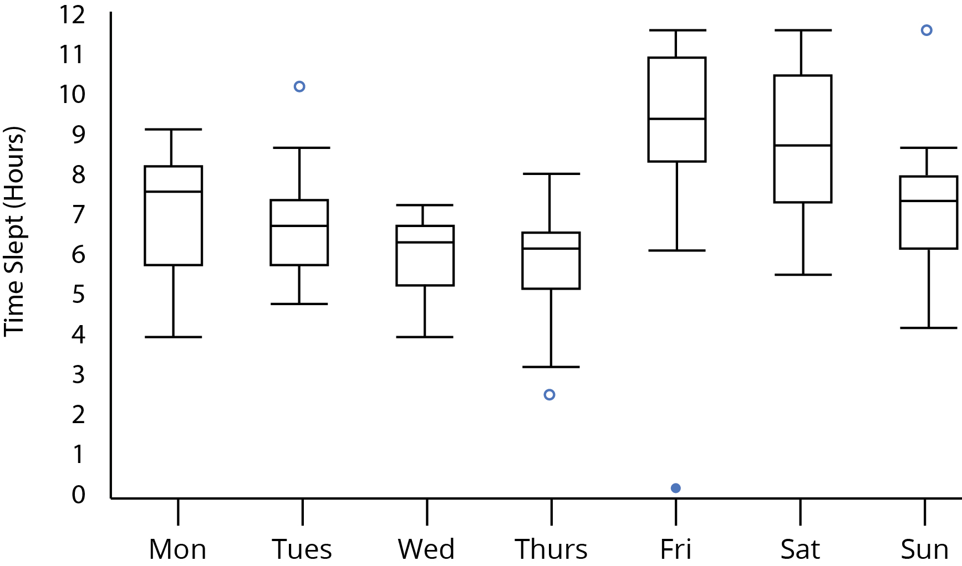
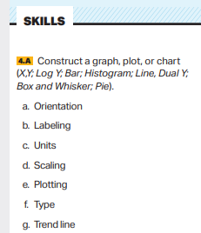
WHAT COULD BE ON THE EXAM?
FROM 2019 CED
EXPECT to interpret/draw graphs in FRQs on the AP Biology Exam
NOTE: Students taking digital exams this year
will not be asked to draw or graph as part of their response
Note: Graph titles have not earned points since the redesign in 2012, but I have always told my students that graphs need a title as a good scientific practice.
Images from:
https://www.schoolsofkingedwardvi.co.uk/wp-content/uploads/2017/07/pie_chart.png
2013 AP Bio Released exam
https://plot.ly/static/img/literacy/boxplot/boxplotfig9.jpg
https://stats.idre.ucla.edu/wp-content/uploads/2016/02/barcap9.png

Slide 39

WHAT COULD BE ON THE EXAM?
You will be provided a copy of the
AP BIOLOGY Equations and Formulas Sheet on the Exam
More math and stats have been added in recent years.
Assume you will see questions on the exam dealing with problems from the Equations and Formulas sheet
Standard deviation/SEM
Hardy-Weinberg
Water/solute potential
Chi-square
Population/growth rates
Simpson’s Diversity index

Slide 40
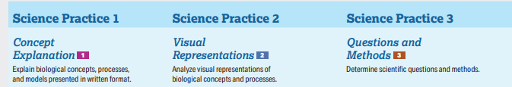
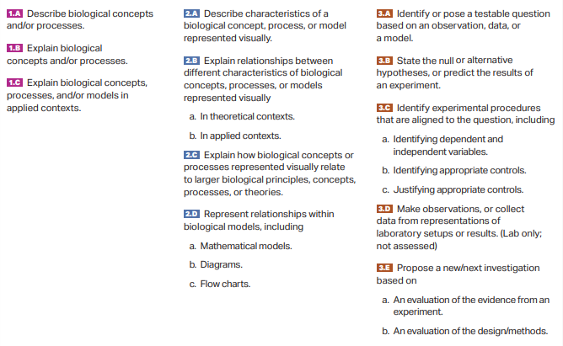
FROM 2019 CED
REVIEW THE SCIENCE PRACTICES
Exam questions are created by linking a science practice to one of the Essential Knowledge statements from the CED

Slide 41
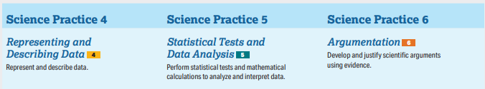
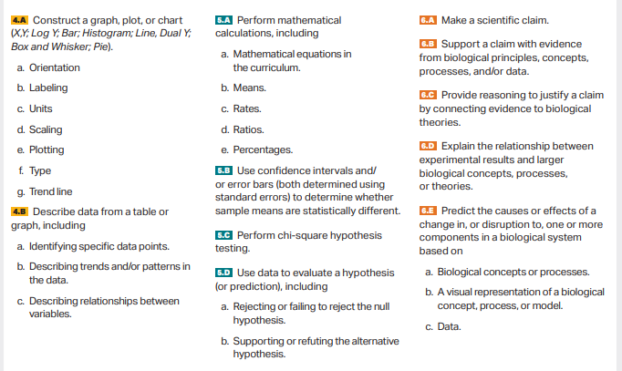
FROM 2019 CED
REVIEW THE SCIENCE PRACTICES
Can you do the things listed in the Science Practices?

Slide 42
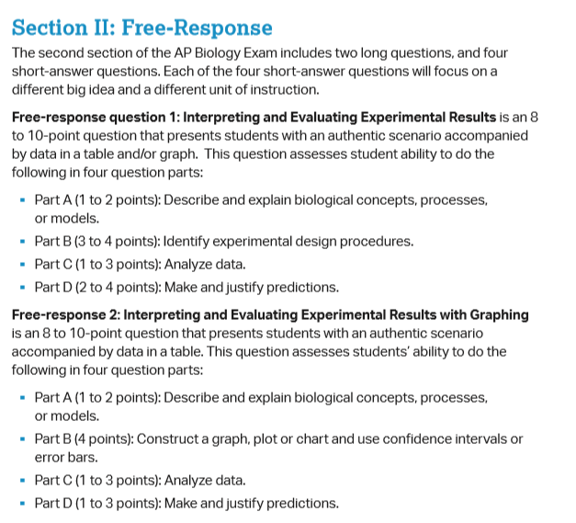
FROM 2019 CED

Slide 43
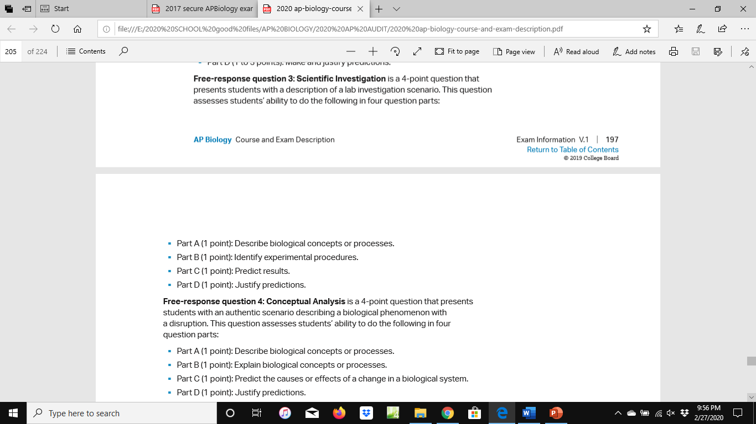
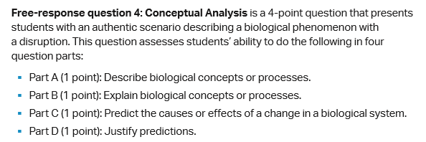
FROM 2019 CED

Slide 44
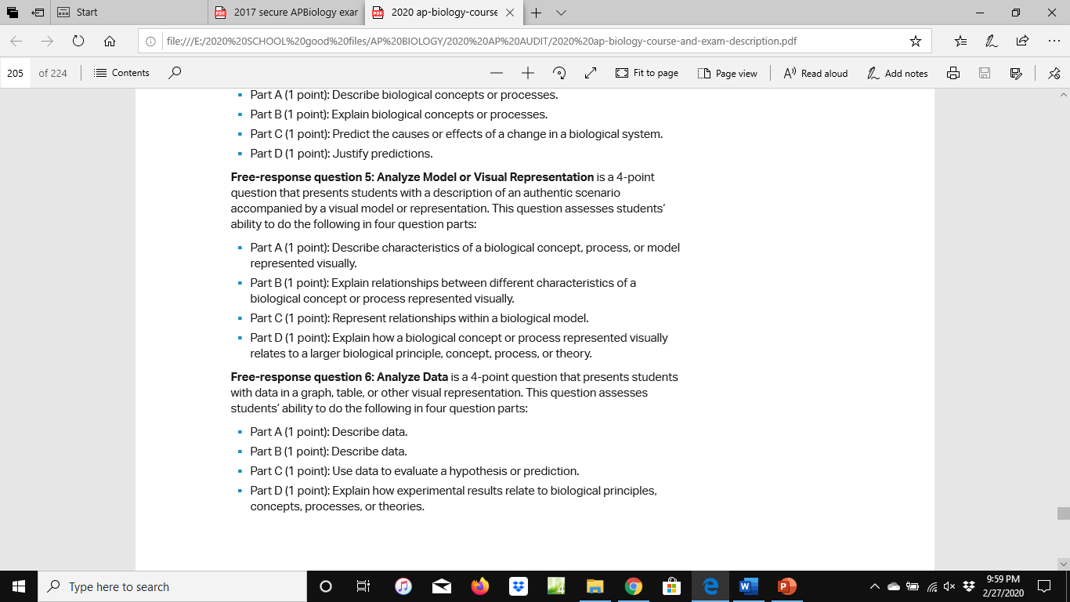
FROM 2019 CED

Slide 45
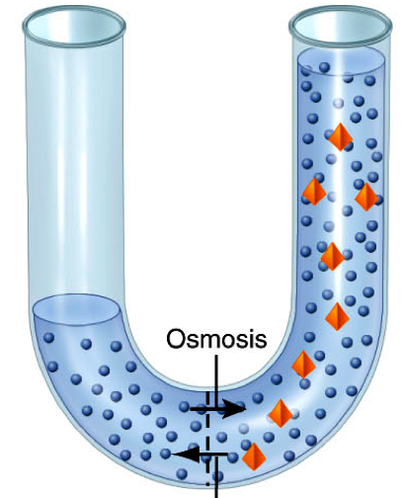
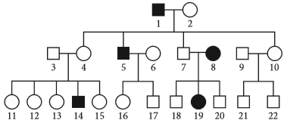
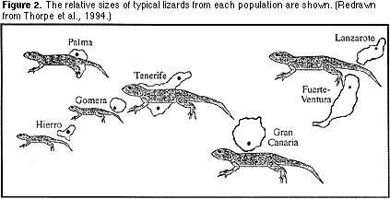
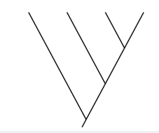
2019 AP BIO CED
http://classconnection.s3.amazonaws.com/544/flashcards/666544/png/osmosis1315238070090.png
https://ucmp.berkeley.edu/fosrec/Filson.html
WHAT COULD BE ON THE EXAM???????
I DON’T CLAIM ANY INSIDER INSIGHT BUT JUST BASED ON MY PAST EXPERIENCE AS AN AP BIOLOGY TEACHER, I BELIEVE THE FOLLOWING TOPICS HAVE APPEARED MORE THAN FREQUENTLY ON PAST AP EXAMS AND ARE ALSO REPRESENTED IN THE 2019 CED SAMPLE QUESTIONS
Draw/Interpret CLADOGRAMS
Analyze PEDIGREES to predict inheritance patterns
HYPOTONIC/HYPERTONIC relationships in real world situations
EVOLUTION, EVOLUTION, EVOLUTION!
NOTE: Images are NOT from SECURE TEST QUESTIONS

Slide 46

START STUDYING EARLY!
This is not a test where cramming a couple of days before works!
MAKE A STUDY PLAN IF YOU ARE TAKING MULTIPLE AP EXAMS!
https://4.bp.blogspot.com/-c4S-oBYcfyw/VxubmHJk7OI/AAAAAAACGeQ/gHyZ8_XMkM8D_GApOHirX5w6GqUQ_yduwCLcB/s1600/tyrion-meme-final.jpg

Slide 47
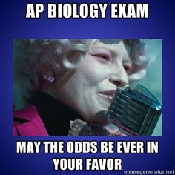


FIRE UP ! ! ! !
INSPIRATIONAL VIDEO
EXAM PREP LINKS
* Info at beginning is from old format
https://i.pinimg.com/736x/f3/7a/0c/f37a0c58955aebc2aabb434d24c98354--broadway-quotes-movie-quotes.jpg

